Slide 1
Course Introduction
To watch lecture video click link below
Lecture 0 video
To view slides, continue to next slide

Slide 2
CS 3650 Computer Architecture (4)
Summer 2021
Asynchronous Mode of Instruction
Course Introduction

Slide 3
Summer 5-week offering: extremely compact!
Expected/suggested time to be spent:
Lectures: 4 days a week
3 hours each day
+ time for assignments
3x regular semester
It’s 4-unit course!

Slide 4
Asynchronous Mode of Instruction: Tips
Take lectures on your own pace
Please be ahead of each milestone!
This is one of the keys for your success!
Pay attention to assignments due dates
Due dates are “lock” steps sync with learning activities
Align the activities: lectures, assignments, and discussions.
Tests are also “lock” steps
Study for it, but don’t be stressful
Post or check discussions frequently
keep yourself alive and active in the virtual classroom
Zoom: visit office hours and/or request review sessions
A great challenge to all of us!

Slide 5
Platforms
Materials posted are for this class only; no sharing/posting to the outside of the class.
CPP resources
Canvas: all course documents
Please check cpp emails daily
Announcements may be sent via emails
zyBooks (learn.zybooks.com)
There is a dedicated zyBook as our textbook.
Sign up account at zyBooks site and purchase the textbook.
Zoom (meeting id: 9098694052)
Feel free to drop in at any office hours
M 9- 9:30am, W 4-4:30pm, F 1-1:30pm
May request a session for review and Q&As

Slide 6
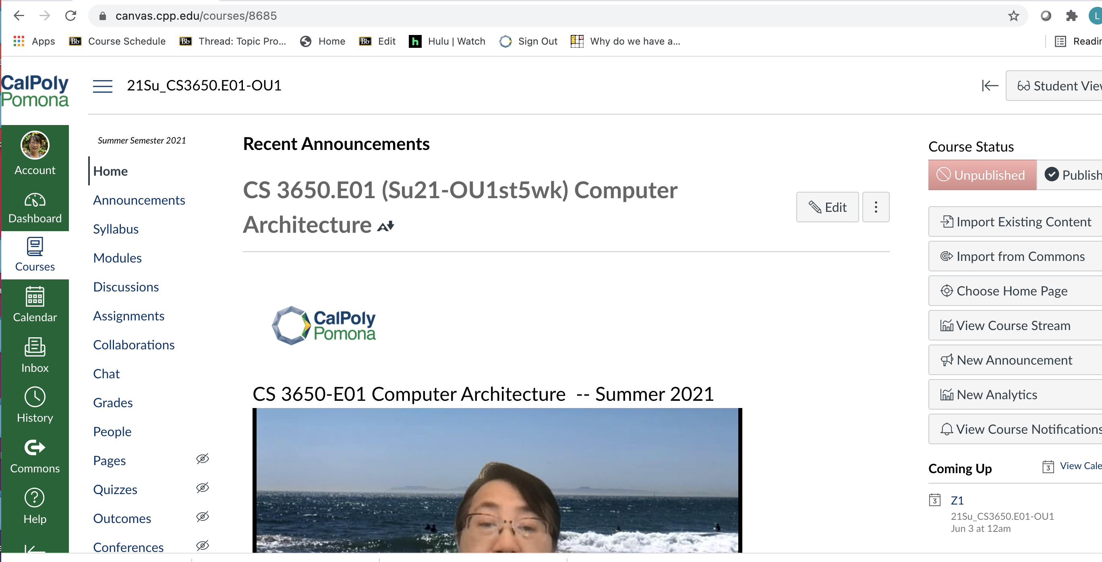
Required
Feel free to use by teams but not monitored/supported by instructor

Slide 7
Course Outline
Introduction and CPU Performance (Lecture 1)
Computer Logic (Lecture 2)
Flip-Flops and Sequential Machines (Lecture 3)
Instruction Set Architecture (Lecture 4)
Arithmetic for computers (Lecture 5)
Integer operations and how to build an ALU
Floating point representations and operations
The processor (Lecture 6)
Constructing a processor datapath to execute our instructions
Design control units to control instruction execution
Pipelining to improve performance (Lecture 7)
Memory: caches and virtual memory (Lecture 8)
Multicore Architecture: Design Trend (Team Project)

Slide 8
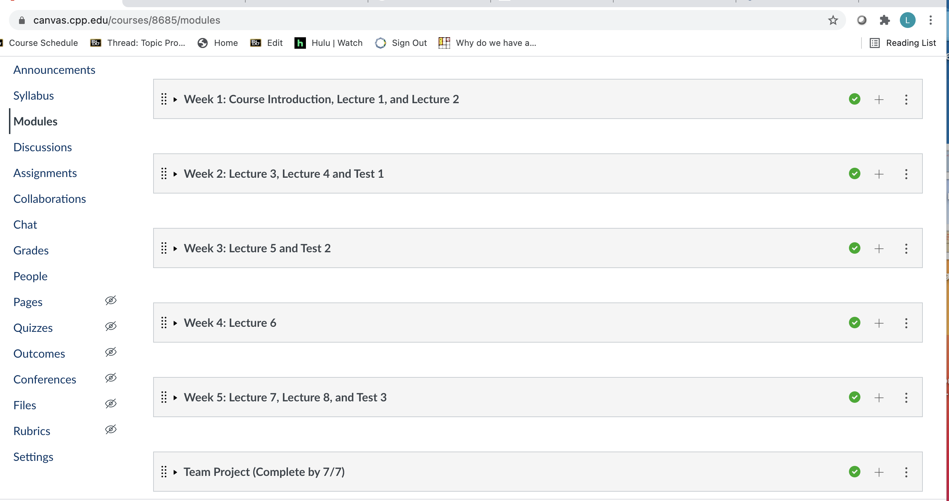
Canvas 5-week Modules

Slide 9
Collaboration among classmates
Strongly recommend you study in a small group setting
More effective learning experience
Build up your remote collaboration experience
A lot of tools available
Canvas collaborations, Discord, Microsoft Teams, …
Your choice, not enforced nor graded for this class
Teamwork
Some participation assignments (e.g. P2, P3, P4)
A team project in the last module
Study of alternative architecture such as multicore processors etc.
Team size: 1 to 4 allowed
recommended: 2 – 3 members per team

Slide 10
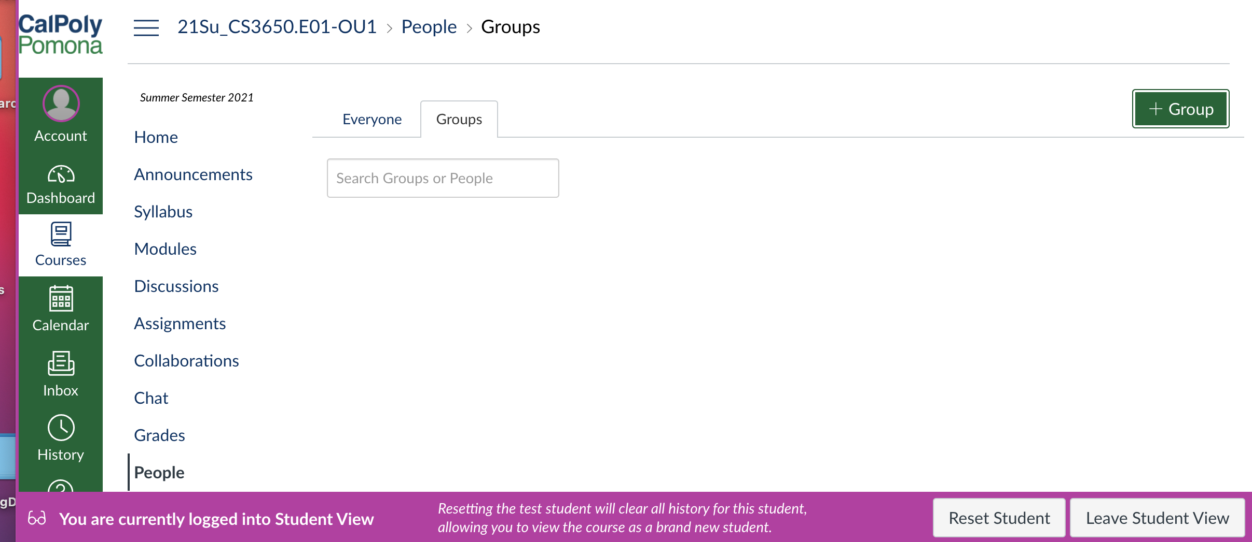
Students self create/join groups first;
Q&A on teams Friday office hour zoom.

Slide 11
Syllabus
Canvas -> Syllabus -> highlighted link
Please read the complete syllabus carefully
Points system (see syllabus for grade assignment policy)
Discussion Participation (5 x 10 points) 50 points
zyBook Activities (10 x 10 points) 100 points
Homework (5 x 20 points) 100 points
Team Project (1 x 50 points) 50 points
Tests 300 points
Total 600 points

Slide 12
Assignments
Participation (P1 – P5)
Canvas -> Assignments
zyBook Activities (Z1 – Z10)
Assignment: on zyBook as well as Module activities
all activities including challenging ones of designated sections
Homework (H1 – H5)
Canvas -> Assignments
Technical issue: GradeScope submission
Working on it (hope it’s transparency to students)
See Class Schedule at the end of syllabus

Slide 13
Tests
Not available on Canvas yet. See Module for available dates.
Canvas -> Week 2, Week 3, Week 5 modules.
Each test must be completed before cut-off time
See Class Schedule for (a range of) dates for each test
Once started, must complete the test within the allocated time
Prior to each test, you may request/join a review session
During my office hours or select a time convenient to a group of students interested for a review session
At most two review sessions (in addition to office hours) will be given for each test

Slide 14
Team Project
Better stay with the same team as participation assignment
Study a multicore or an advanced CPU/GPU architecture
P3: select a topic (i.e. a CPU/GPU)
At most two teams could work on the same one
May change later (if the new choice not taken yet)
Deliverable
A presentation file introducing the architecture features of this new/contemporary CPU
Can start and submit the team project at any time
Don’t have to wait till the due date

Slide 15
Finally …
Let’s work together to achieve our goal.
Any question feel free to email me lyang@cpp.edu
or join my office hour zoom
To-Do List
zyBooks textbook sign up and purchase;
Explore Canvas;
Read syllabus thoroughly;
Post self-introduction at Discussions (optional).

